Slide 1
Question Formulation Technique: Teaching Students to Ask Their Own Questions
“Just when you think you know all that you need to know, you ask another question and discover how much more there is to learn.”
– Sixth grade student, J.L. Stanford Middle School, Palo Alto, CA
“The reasons behind their questions often bowl me over with their sincerity, the fact that [they] really want to know the answers because it’s important to them, or they feel it would be important for others to know.”
– 4th Grade Teacher, Chicago
Jodi Hufendick, Instructional Specialist, Yakima School District, hufendick.jodi@gmail.com
Molly Berger, Instructional Improvement Coordinator, Educational Service District 105, molly.berger@esd105.org

Slide 2
Our purpose today:
Examine the Question Formulation Technique, which teaches students to create their own questions, and then apply it to their own teaching

Slide 3
Our agenda:
Participate in a QFT protocol
Examine the protocol as an instructional strategy
Discuss the role of questioning in learning
Plan for integration of the strategy into own work

Slide 4
RULES FOR PRODUCING QUESTIONS
Ask as many questions as you can
Do not stop to discuss, judge or answer the questions
Write down every question exactly as it is stated
Change any statement into a question
Rate yourself on each of these rules.

Slide 5
Question Formulation Technique Small Group Worksheet

Slide 6
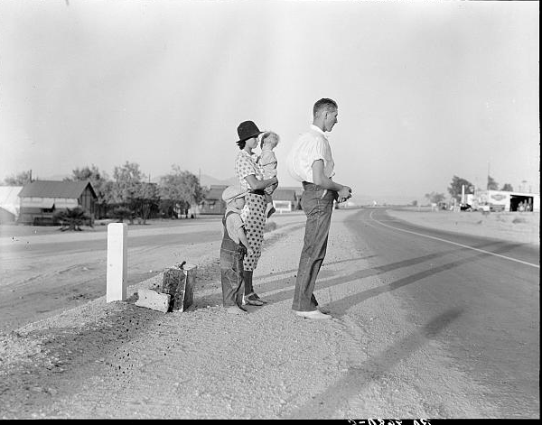
http://loc.gov/pictures/item/fsa1998021756/PP/Library of Congress

Slide 7
KINDS of QUESTIONS
What are closed-ended questions?
What are the advantages of closed-ended questions?
What are the disadvantages of closed-ended questions?

Slide 8
Kinds of Questions
What are open-ended questions?
What are the advantages of open-ended questions?
What are the disadvantages of open-ended questions?

Slide 9
Change your questions
Review your list of questions and change one closed-ended question into an open-ended.
Then, change one open-ended question into a closed-ended one.

Slide 10
Prioritize Your Questions
Choose the three questions your group most wants to know the answers to.
Keep in mind the QFocus.
List your three priority question on the back of your recording sheet.

Slide 11
Share Your Questions
Please share:
The questions you changed from closed to open-ended and from open-ended to closed. Read each question as originally written and how it was changed
Your three priority questions
Your rationale for selecting those three
The numbers of your priority questions

Slide 12
Reflection
What did you learn from your group members in this process?
How would you apply this learning to another situation?

Slide 13
How will you use these questions?
How are you going to use your three priority questions?

Slide 14
Deconstructing the Process
What was the step?
What does it draw out of the student?
How is it important to the process?
How is it important to student learning?

Slide 15
Application
Individually list ideas for using this protocol with students and/or staff
Now, share with your group
Discuss the following
What challenges do you anticipate?
What benefits do you see?

Slide 16
Application
Whole group sharing

Slide 17
Notes and ideas
Importance of the Q-focus
Learning drives the protocol
How do we prevent killing a good strategy?

Slide 18
Where do I find more information?
The Right Question Institute
http://rightquestion.org/
Educator Network

